Slide 1
Unified national artificial insemination program (unaip) updates, herd recording & ruminant registry
DR. PAUL C. LIMSON
Officer-In-Charge, Livestock Development Division
& UNAIP National Coordinator
2013 FCRAP Cattle Congress
Valencia Hotel, February 2, 2013

Slide 2
Outline of the Presentation
Unified National Artificial Insemination Program (UNAIP) Updates
Herd Recording
Ruminant Registry

Slide 3
UNIFIED NATIONAL ARTIFICIAL INSEMINATION PROGRAM (UNAIP) Updates

Slide 4
Program Brief (1)
Provides strategic direction in the current AI efforts
Harmonizes the undertakings of BAI, LDC, PCC, NDA & RFUs in carrying out efficient and effective livestock breeding programs using AI technology
Provides better opportunities for livestock farming communities by enhancing their competitiveness through an institutionalized AI delivery system at the village level

Slide 5
Program Brief (2)
BAI as the lead implementing agency
Further intensifying the institutional capability of LGUs
Development of human resources
Provision of equipment
Strengthening on institutional linkages

Slide 6
Goal / Objective
Accelerate AI diffusion rate to 30% of breedable cattle & water buffaloes
Increase conception rate to cattle & water buffaloes at the field level to 65% & 45% respectively
Institutionalization of AI services to 50% of the LGUs

Slide 7
Strategy
Integrate the smallholders into the total production and marketing systems through provision of institutionalized AI & extension services; &
Strengthening of partnerships with other stakeholders, i.e., CSOs, academe, and the business/market community
AI is a tool in achieving productivities, either for beef or dairy

Slide 8
Features
DA-RFUs play a crucial role in program implementation & localization
Implemented under a COST-SHARING SCHEME:
DA covers the training of technicians, cattle & water buffalo semen supply, LN2 tank & AI gun for new LGU program recipients & information materials
LGU provides full-time AI technician, travelling expenses, cost of LN2 & AI supplies (AI gloves & straw sheath)

Slide 9
System (1)
AI structure
Policy level: Advisory Committee (GIP)
Program Management Group (PMG)
Regional Management Group (RMG)
AI Technician identification & accreditation
Semen comes from performance tested sires
Animal identification system – not yet in place

Slide 10
System (2)
Adopt a common training policy in selection of trainees, unified training curriculum & utilizing trainors from DA & academe
Improved reporting & monitoring system using IT
Advocate the use of natural estrous (heat)
Incentive, rewards & recognition system that are results or output-driven
Cash-calf incentive PhP 100

Slide 11
System (3)
Establishment of LN2 generating plants in non-JOCV / JICA coverage areas
DA-BAI AO# 1, series of 2010 revises DA AO#1, s. of 2009 sets the Implementing Guidelines for the operation of LN2 plants

Slide 12
Program Performance (1)
AI Services Conducted
2009 – 44,016 services
2010 – 53,296 services
2011 – 73,975 services
2012 – 97,931 services
Beef cattle – 38,763
Dairy cattle – 2,784
Buffalo – 55,214
Goat – 1,170

Slide 13
Program Performance (2)
Animals Produced
2009 – 13,052 animals
2010 – 17,100 animals
2011 – 17,795 animals
2012 – 20,535 animals
Beef Cattle – 13,411 calves
Dairy Cattle – 597 calves
Buffalo – 6,489 caracalves
Goat – 360 kids

Slide 14
Program Performance (3)
Animals Confirmed Pregnant
2010 – 17,395 animals
2011 – 16,637 animals
2012 – 9,006 animals out of 14,017 diagnosed or 64.25% (partial report)
Beef Cattle – 6,234 / 9,055 (68.85%)
Dairy Cattle – 420 / 639 (65.73%)
Buffalo – 2,352 / 4,323 (54.41%)

Slide 15
Program Performance (4)
Beneficiaries – 65,287 farmers
16,322 male
48,965 female
484 actively reporting AI Technicians via e-Report system out of > 1,000 accredited AI technicians
e-Report Training in RFU XII last November 21-23, 2012
Mr. Ryoichi Fujino, new JOCV arrived last October 3 & deployed November 12, 2012
4 additional LN2 plants awarded by DA to ALV Technologies

Slide 16
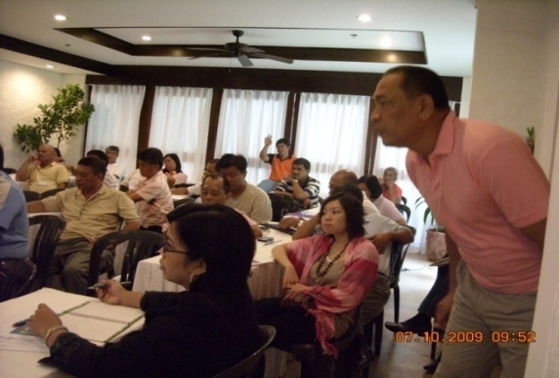
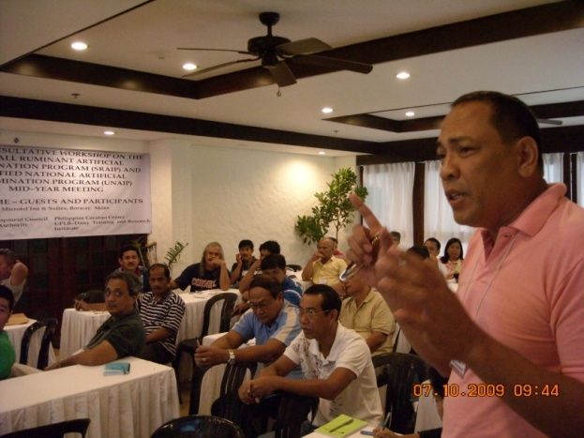
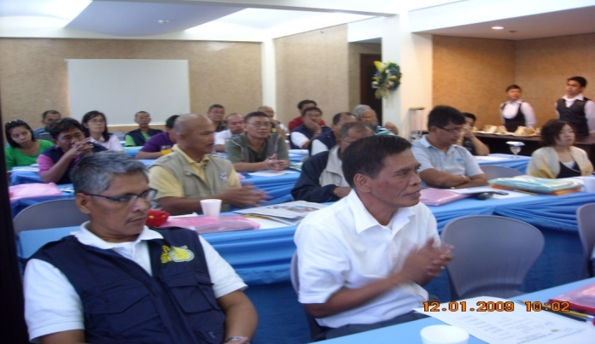
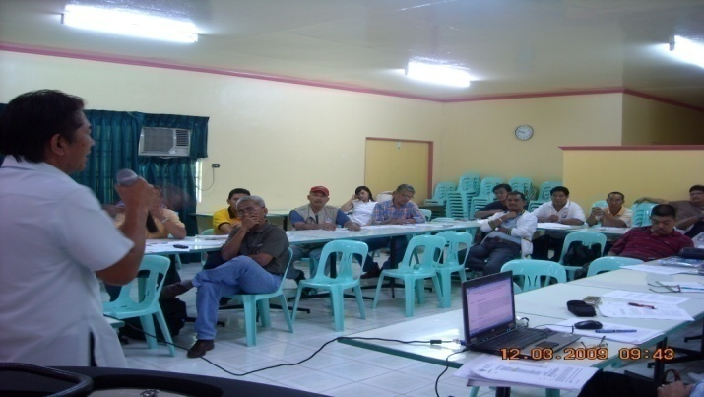
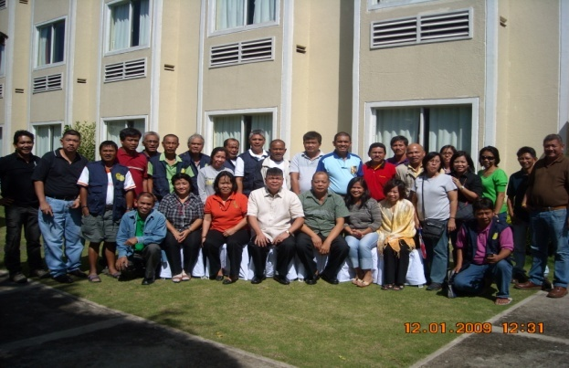
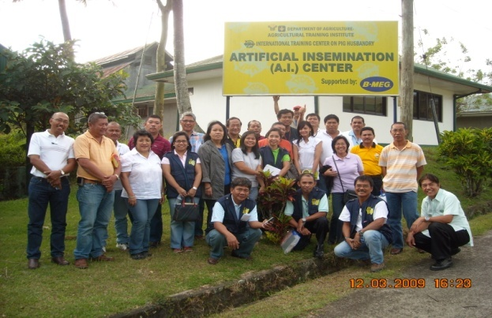
Regular Program Review, Planning & Consultative Meetings among RAICs

Slide 17
12-YEAR ACCOMPLISHMENT
2006 & 2007 – LN2 plants stopped operations
AI & CD – includes cattle & carabao

Slide 18
01-12 Cattle Accomplishment

Slide 19
01-12 Carabao Accomplishment

Slide 20
09-12 Goat Accomplishment

Slide 21
Strategies for 2013 (1)
AI is the best tool for disseminating genetics / materials
Increase localization of AI services
Include animals inside ranches – in response to Cattle Road Map
Sustain the AI Cash Calf Incentive Program
Only ACCREDITED TECHNICIANS will be processed
Free semen from tested sires

Slide 22
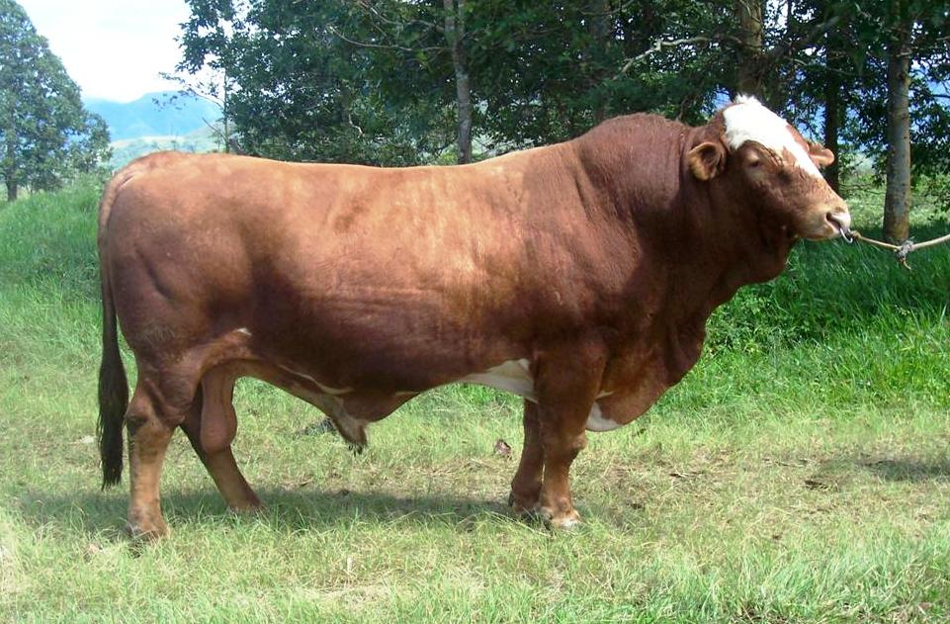
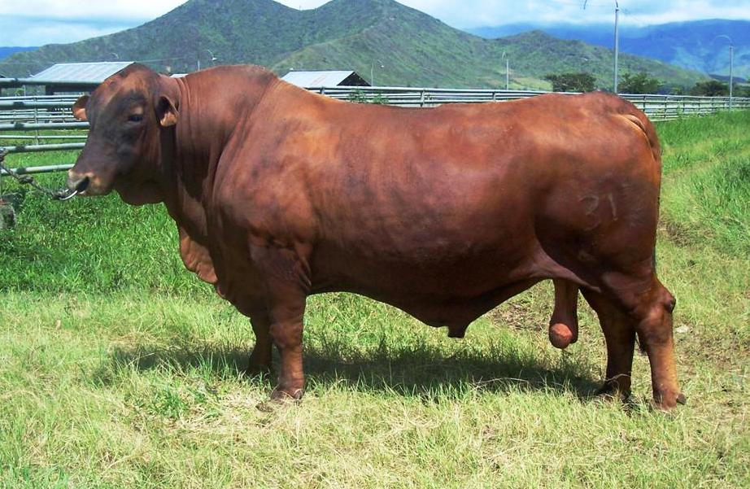
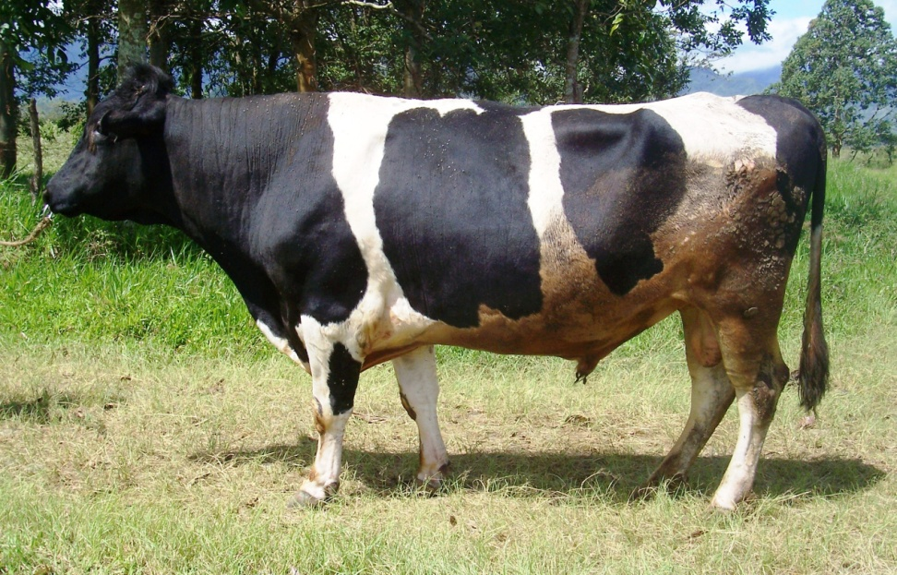
Donor Bulls at NABC

Slide 23
Strategies for 2013 (2)
Improve program reporting & monitoring
Application of electronic reporting system even in the AICCI Program
Recognition program for Top AI Performers
Top 3 AI Technicians (calves produced)
Requesting for the establishment of additional LN2 plants
Batac, Ilocos Norte; RFU XI, Davao City; CSDU; NABC–Bukidnon; Antique, Pili

Slide 24
Strategies for 2013 (3)
Continue to strengthen linkages with key livestock agencies & peoples organizations
Philippine Carabao Center
National Dairy Authority
Dairy Training & Research Institute
Dairy Confederation of the Philippines
Federation of Cattle Raisers Association of the Philippines
Incorporation of Small Ruminant AI into UNAIP
Reformulation of UNAIP Program Document

Slide 25
Any questions so far?

Slide 26
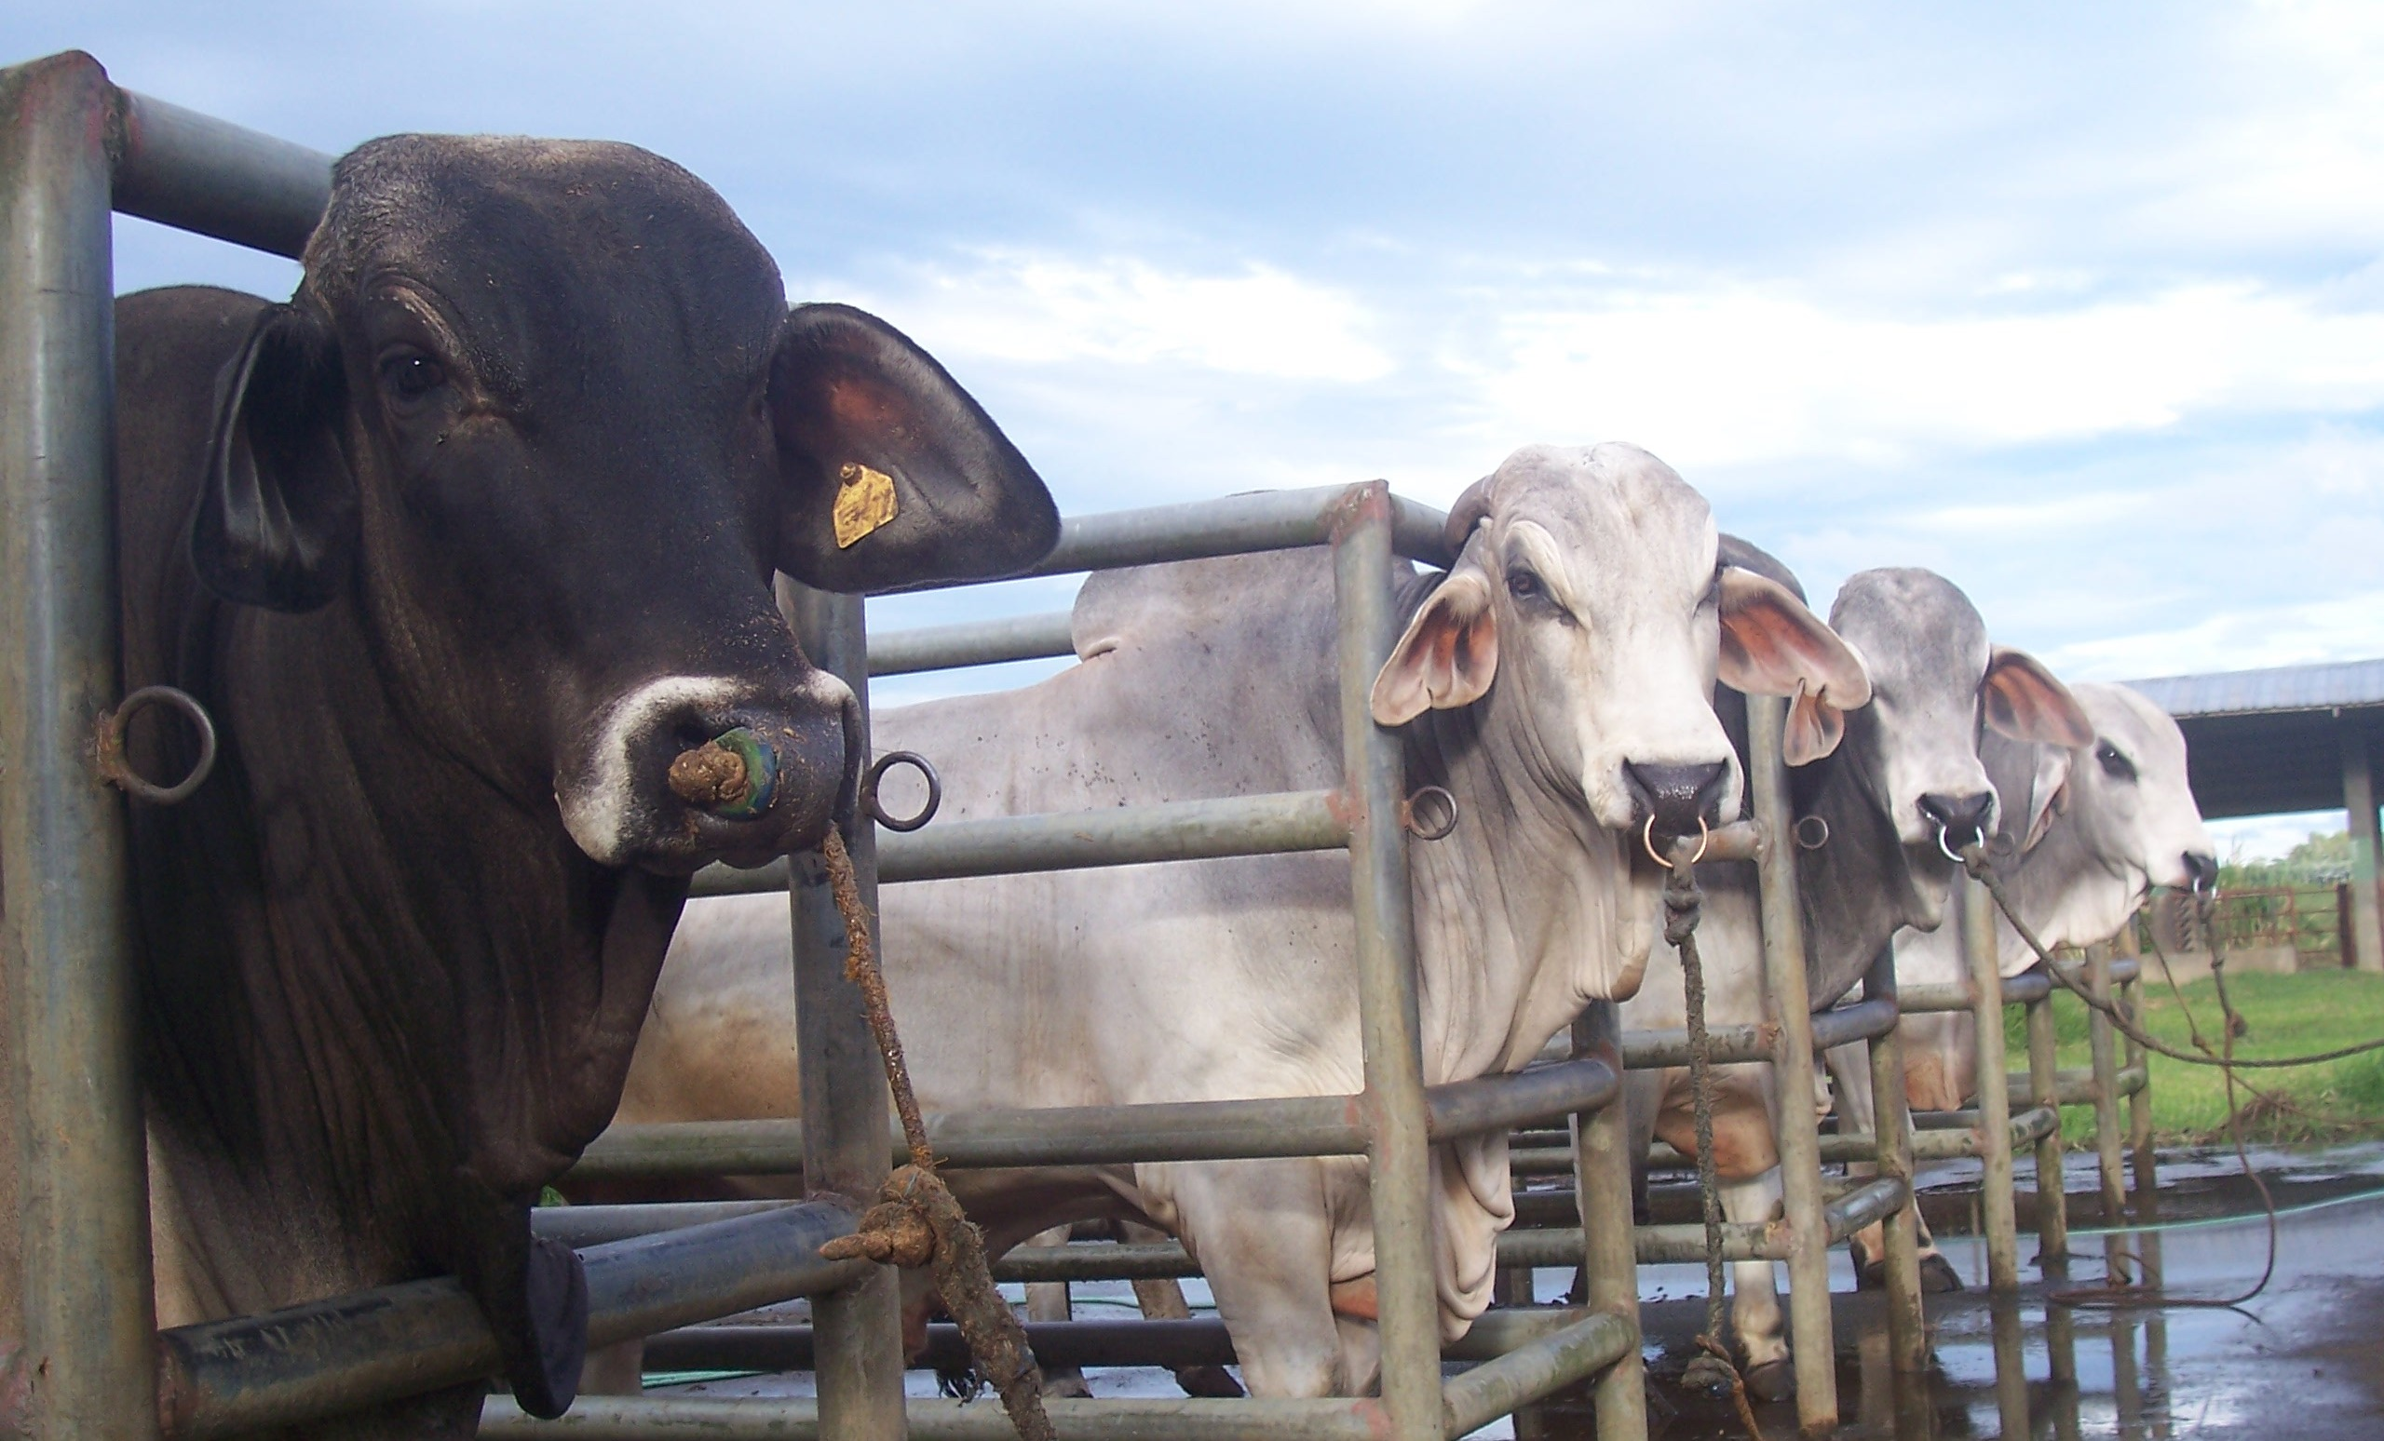
HERD Recording

Slide 27
Records
Detailed information regarding an animal
Can be:
Pedigree papers
Foreign registration number
Performance details
Birthweight
Weaning weight
Yearling weight
Final Weight
Scrotal circumference
Transfer of ownership

Slide 28
Importance of Data Recording
Aid in management decisions
Retain animals (selection)
Replace animals (culling)
Reference
Pedigrees or bloodline
Performance of animal (EBVs or estimated breeding values)
Animals can be sold for a good price

Slide 29
What to record
Pedigree
Sire
Dam
Date of Birth
Color
Breed
Type of Birth
Owner / Breeder
Registration Number
Performance Data
Weights
Birth weight
Weaning weight
Yearling weight
Mature cow weight
Traits
Scrotal circumference
Mating / Breeding Details
Sire / Dams
Joining weight

Slide 30
What to record
Health
Treatment / Vaccinations
Dates pulled / treated
Disease suspected
Drugs used, dosage
Outcome of treatment
Person who treated the animal
Movement
Date sold
Date transferred
Fate
Active
Died

Slide 31
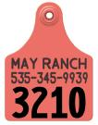
Animal Identification
Permanent
Unique
Names
Alphanumeric
International year code

Slide 32
Recording can be:
On-farm Recording
Index card
Computerized/Commercial softwares
Group / Breed Recording @ BAI
National Performance Recording
Brahman Registry

Slide 33
National Performance Recording
Started as DA-ACIAR Project on “Performance Evaluation and Genetic Improvement of Ruminants in the Philippines” from 2000–2005
Objectives:
Store existing information into a national database
Research to estimate genetic parameters
Customize existing BREEDPLAN® software
Train Filipino scientists on self sufficiency
Identified “elite animals”
9 government farms & 17 private farms enrolled

Slide 34
Beef Cattle Farms Enrolled
Busuanga Breeding & Experimental Station
Milagros Livestock Production Center
National Artificial Breeding Center – Lot 184
Nueva Ecija Stock Farm
Dumarao Livestock Production Center*
Malaybalay Stock Farm*
Ubay Stock Farm*
National Center for Forage & Pasture*
Asean Goat and Sheep Center (Senepol)*
ANSA Genetics, Inc.
5A Cattle Breeding Farm
Carmel Import Export Corp.
Fortuna Brahmans, Inc.
Sarangani Agric. Co. Inc.
JOLISA Agribusiness Corp.
PESO Farm
Charles Lim Farm
Umalag Farms, Inc.*
Bernales Farm*
Montesclaros Ranch*
Dream Field, Inc.*
JADECO*
Jopson Farm*
Hacienda Bigaa, Inc.**
SAL Farm*
ATK Ranch*
* – inactive;
** – no data yet but enrolled

Slide 35
Flow of Information
Government
Nucleus
Farms
PBBA
Members
Private Farms
Regional AI
Coordinators
EBVs / Herd
Reports
CDMU
Central Data
Management Unit

Slide 36
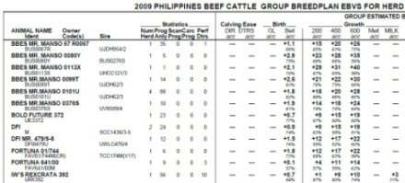
Sample EBV Report
2009 PHILIPPINES BEEF CATTLE GROUP BREEDPLAN EBVS FOR HERD BOOK SIRES
ANIMAL NAME | SIRE |  |  |  | GROUP ESTIMATED BREEDING VALUES
 |  | Statistics |  |  | Birth | Growth
 |  | Num | Prog | Perf | Bwt | 200 | 400 | 600 | MILK
IDENT |  | Herd | Anly | Dtrs | acc | acc | acc | acc | acc
BBES MR. MANSO 67 R0067 |  | 1 | 35 | 1 | +1.1 | +15 | +20 | +26 | +0
BUS0067R | UJDH954/2 |  |  |  | 89% | 85% | 83% | 75% | 0%
BBES MR. MANSO 0099T |  | 1 | 14 | 0 | +2.6 | +21 | +22 | +30 | +0
BUS0099T | UJDH62/3 |  |  |  | 83% | 78% | 75% | 68% | 0%
BBES MR. MANSO 0101U |  | 4 | 88 | 0 | +1.8 | +18 | +20 | +28 | +0
BUS0101U | UJDH62/3 |  |  |  | 92% | 89% | 86% | 80% | 0%
BOLD FUTURE 372 |  | 1 | 23 | 0 | +0.7 | +9 | +15 | +19 | +0
UE3372 | UV8589/4 |  |  |  | 77% | 67% | 60% | 60% | 0%
JDH SIR DON MANSO 974/4 |  | 2 | 109 | 17 | +0.9 | +17 | +20 | +28 | +4
UJDH974/4 |  |  |  |  | 94% | 89% | 86% | 84% | 25%
IW'S REXCRATA 392 |  | 1 | 56 | 10 | +0.7 | +1 | +9 | +10 | +3
UIW392 |  |  |  |  | 89% | 87% | 80% | 74% | 31%
AVERAGE EBVS FOR 2007 BORN CALVES |  |  |  |  | +1.0 | +10 | +16 | +21 | +3

Slide 37
Sample EBV Report (2)
2009 PHILIPPINES BEEF CATTLE GROUP BREEDPLAN EBVS FOR HERD BOOK SIRES
ANIMAL NAME | SIRE |  |  |  | GROUP ESTIMATED BREEDING VALUES
 |  | Statistics |  |  | Birth | Growth
 |  | Num | Prog | Perf | Bwt | 200 | 400 | 600 | MILK
IDENT |  | Herd | Anly | Dtrs | acc | acc | acc | acc | acc
BBES MR. MANSO 67 R0067 |  | 1 | 35 | 1 | +1.1 | +15 | +20 | +26 | +0
BUS0067R | UJDH954/2 |  |  |  | 89% | 85% | 83% | 75% | 0%
BBES MR. MANSO 0099T |  | 1 | 14 | 0 | +2.6 | +21 | +22 | +30 | +0
BUS0099T | UJDH62/3 |  |  |  | 83% | 78% | 75% | 68% | 0%
BBES MR. MANSO 0101U |  | 4 | 88 | 0 | +1.8 | +18 | +20 | +28 | +0
BUS0101U | UJDH62/3 |  |  |  | 92% | 89% | 86% | 80% | 0%
BOLD FUTURE 372 |  | 1 | 23 | 0 | +0.7 | +9 | +15 | +19 | +0
UE3372 | UV8589/4 |  |  |  | 77% | 67% | 60% | 60% | 0%
JDH SIR DON MANSO 974/4 |  | 2 | 109 | 17 | +0.9 | +17 | +20 | +28 | +4
UJDH974/4 |  |  |  |  | 94% | 89% | 86% | 84% | 25%
IW'S REXCRATA 392 |  | 1 | 56 | 10 | +0.7 | +1 | +9 | +10 | +3
UIW392 |  |  |  |  | 89% | 87% | 80% | 74% | 31%
AVERAGE EBVS FOR 2007 BORN CALVES |  |  |  |  | +1.0 | +10 | +16 | +21 | +3
If selecting for low birthweights for heifers:
101U or 974/4
If selecting for growth at 400 days:
99T or 974/4
If selecting an overall herd bull:
974/4

Slide 38
Philippine Brahman Breeders Association (PBBA)
Incorporated January 8, 2008 in recognition of the need to strengthen the Brahman cattle industry
Its pioneering project is the establishment of the Brahman Registry/Herdbook in collaboration with the Bureau of Animal Industry – Livestock Development Division
Regular meetings held since 2009

Slide 39
Founding Members
President Mr. Martin M. Gomez
Rancho Consuelo Canlubang
Vice-president Mr. Adrian L. Favis
Fortuna Brahmans
Secretary Mr. Billy L. Badilla
CIEC Farm
Treasurer Mr. Ian S. Abalos
5A Cattle Ranch
Directors Mr. Antonio C. Nocom
Mr. Edwin O. Sanchez
ANSA Genetics, Inc.
Mr. Alex Alcantara
Mr. Fermin Gallarita
Sarangani Agricultural Co., Inc.

Slide 40
PBBA Launching
PBBA – BAI MOA Launching, February 24, 2010, OD Conference Room

Slide 41
PBBA Standards
Purebred
Pedigreed (American or Australian Brahman Breeders Association)

Slide 42
PBBA Registry
Integrated pedigree and performance recording system utilizing customized BREEDPLAN® software
Herdbook details:
Book 1 – purebred animals
Book 2 – Appendix animals (A, B, C, D)

Slide 43
Sample Pedigree
PBBA
BREEDPLAN®

Slide 44
Agreements Reached so far
Schedule of Fees
Membership
Calf Recording
Female Registration & Appendix Animals
Transfers
Standards of Excellence
Combination of American & Australian Brahman Breeders Associations’ standards
Pedigree certificate format
Forms to be adopted:
Animal Registration
Birthweight
Succeeding weight
Mating Details
Semen Declaration

Slide 45
Agreements Reached so far
Each member should be accredited BAI Breeder Farm
ANSA Genetics, Inc.
Fortuna Brahmans
5A Cattle Breeding Farm
SCC – applied in 2011
RCC – apply in 2013
CIEC – apply in 2013
Herdbook
Manual / Guidelines
Special Projects
AI training at Masbate (June 2011)

Slide 46
Calves EBVs over Years (Genetic Trends)

Slide 47
2012 Group BREEDPLAN® Statistics
Trait | Animal Count | Mean
Birth weight | 14,601 | 29.12
200 weight (1) | 6,161 | 147.32
400 weight (1) | 3,052 | 175.83
600 weight (1) | 887 | 241.92

Slide 48
THANK YOU FOR YOUR TIME

