Slide 1
Maximizing Your Breeding Season
Jose Arceo N. Bautista, DVM, PhD.
Federation of Cattle Raisers’ Associations of the Philippines
2013 Convention-General Assembly,
Hotel Valencia, Valencia Bukidnon
February 2-3, 2013

Slide 2
Learning Objectives:
To be able to review the phenomenon of heat in cattle,
Understand the cyclicity of heats in relation to known literature vis-à-vis Philippine experience,
Discuss possible steps to maximize efficiency in reproductive management of cattle herds.

Slide 3
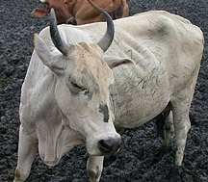
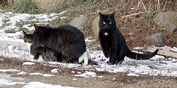
Types of Cyclicity
Polyestrus
Queen
Cow
Sow
Relative E₂
J
F
M
A
M
J
J
A
S
O
N
D

Slide 4
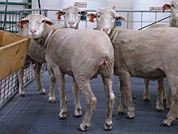
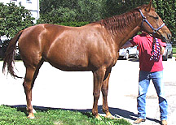
Types of Cyclicity
Seasonally Polyestrus
Short day breeders
(Fall)
Long day breeders
(Spring)
Relative E₂
Relative E₂
J
F
M
A
M
J
J
A
S
O
N
D
J
F
M
A
M
J
J
A
S
O
N
D

Slide 5
Average Reproductive Cycles
Species Length of Length of Ovulation Length of
Estrous Cycle Estrus Pregnancy
cow 21 days 18 hr 11 hr after 282 days
polyestrus end estrus
ewe 17 days 29 hr near end 148 days
seasonal (fall) estrus
sow 21 days 48-72 hr 35-45 hr 115 days
polyestrus after start
estrus
mare 21 days 4-8 days 3-6 day of 335 days
seasonal (spring) estrus
polyestrus (1-2 days
before end of
estrus)

Slide 6
Variation in Cycle Types
Example Type of Follicular Ovulation & CL
Cycle Development CL Formation Function
Cow, ewe, Long Spontaneous Spontaneous Spontaneous
sow, mare
rats, mice, Short Spontaneous Spontaneous Induced
hamsters (4 days) (prolactin)
rabbit, cat, Induced Spontaneous Induced Induced
mink, ferret, (LH surge)
otter, alpaca

Slide 7
CL
Ovulation
CA
Progesterone
PGF
2
α
Estradiol
FSH
LH
-7
- 6
- 5
- 4
- 3
- 2
-1
0
1
2
3
4
5
6
7
8
Days Relative to the Gonadotropin Surge
Diestrus
Proestrus
Estrus
Metestrus
Diestrus

Slide 8
CL
Ovulation
CA
Progesterone
PGF
2
α
Estradiol
FSH
LH
-7
- 6
- 5
- 4
- 3
- 2
-1
0
1
2
3
4
5
6
7
8
Days Relative to the Gonadotropin Surge
Diestrus
Proestrus
Estrus
Metestrus
Diestrus

Slide 9
CL
Ovulation
CA
Progesterone
PGF
2
α
Estradiol
FSH
LH
-7
- 6
- 5
- 4
- 3
- 2
-1
0
1
2
3
4
5
6
7
8
Days Relative to the Gonadotropin Surge
Diestrus
Proestrus
Estrus
Metestrus
Diestrus

Slide 10
CL
Ovulation
CA
Progesterone
PGF
2
α
Estradiol
FSH
LH
-7
- 6
- 5
- 4
- 3
- 2
-1
0
1
2
3
4
5
6
7
8
Days Relative to the Gonadotropin Surge
Diestrus
Proestrus
Estrus
Metestrus
Diestrus

Slide 11
CL
Ovulation
CA
Progesterone
PGF
2
α
Estradiol
FSH
LH
-7
- 6
- 5
- 4
- 3
- 2
-1
0
1
2
3
4
5
6
7
8
Days Relative to the Gonadotropin Surge
Diestrus
Proestrus
Estrus
Metestrus
Diestrus

Slide 12
CL
Ovulation
CA
Progesterone
PGF
2
α
Estradiol
FSH
LH
-7
- 6
- 5
- 4
- 3
- 2
-1
0
1
2
3
4
5
6
7
8
Days Relative to the Gonadotropin Surge
Diestrus
Proestrus
Estrus
Metestrus
Diestrus

Slide 13
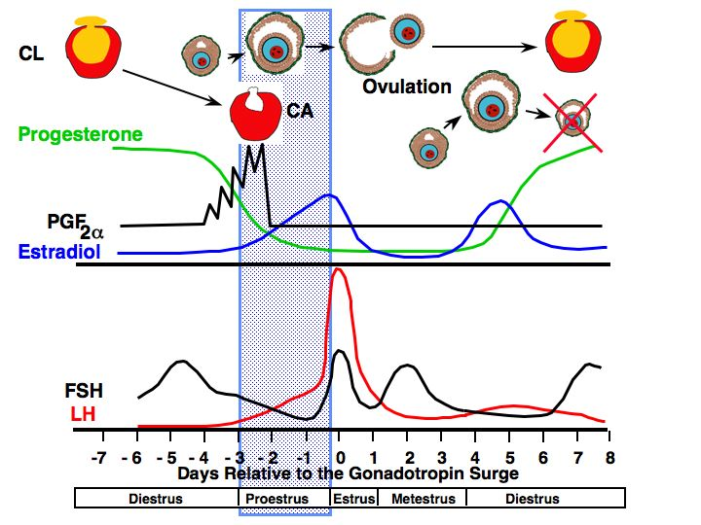
Follicular Phase
Proestrus
Preovulatory follicle enlarges
estrogen increases
vascularity of the female reproductive tract increases
endometrial glands begin to grow
estrogen levels peak

Slide 14
CL
Ovulation
CA
Progesterone
PGF
2
α
Estradiol
FSH
LH
-7
- 6
- 5
- 4
- 3
- 2
-1
0
1
2
3
4
5
6
7
8
Days Relative to the Gonadotropin Surge
Diestrus
Proestrus
Estrus
Metestrus
Diestrus

Slide 15
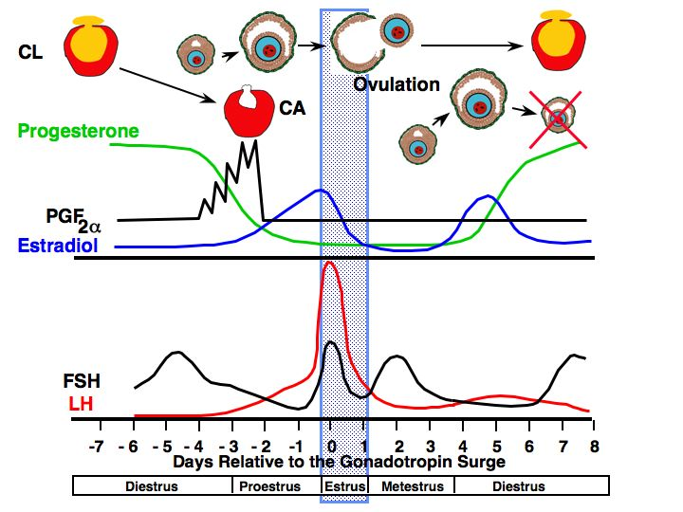
Follicular Phase
Estrus
allows male to mount
estrogen decreases
LH surge occurs
ovulation 24-48 hr after surge of LH
uterine motility high with contractions moving toward oviduct
sperm transport is optimal
cervical mucus volume increases

Slide 16
CL
Ovulation
CA
Progesterone
PGF
2
α
Estradiol
FSH
LH
-7
- 6
- 5
- 4
- 3
- 2
-1
0
1
2
3
4
5
6
7
8
Days Relative to the Gonadotropin Surge
Diestrus
Proestrus
Estrus
Metestrus
Diestrus

Slide 17
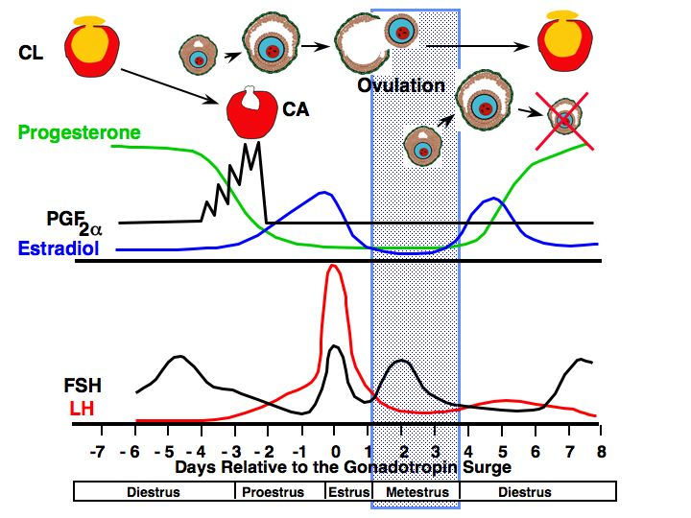
Luteal Phase
Luteal Phase
Metestrus
estrogen low
ovulation in cow
corpus hemorrhagicum present
uterus
contractions subside
endometrial glands continue to grow and become coiled
in cattle bleeding occurs
FSH increases
triggering growth of follicles

Slide 18
CL
Ovulation
CA
Progesterone
PGF
2
α
Estradiol
FSH
LH
-7
- 6
- 5
- 4
- 3
- 2
-1
0
1
2
3
4
5
6
7
8
Days Relative to the Gonadotropin Surge
Diestrus
Proestrus
Estrus
Metestrus
Diestrus

Slide 19
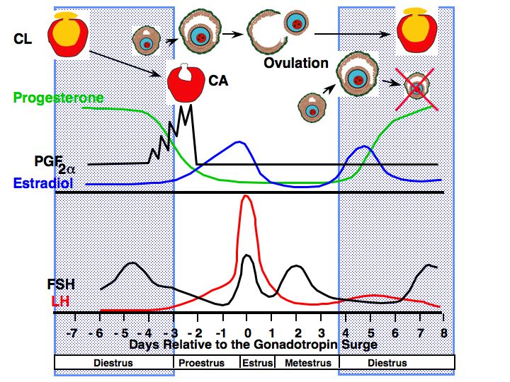
Luteal Phase
Luteal Phase
Diestrus
progesterone high
FSH
Increases at some point to cause growth of ovulatory follicle
Uterus
secrets fluid but volume gradually decreases
contraction stop
CL regresses at the end of this period if female is not pregnant due to PGF release

Slide 20
Characteristics of Estrous Cycles
Cow Ewe Sow Mare
Estrous cycle (days) 21 17 21 21
Proestrus (days) 3-4 2-3 3-4 2-3
Estrus 12-18 hr 24-36 hr 48-72 hr 4-8 days
Metestrus (days) 3-4 2-3 2-3 2-3
Diestrus (days) 10-14 10-12 11-13 10-12

Slide 21
Causes of Anestrus
Pregnancy
Presence of Offspring
Season
Pathology
Nutrition
Stress

Slide 22
Gestational Anestrus
Progesterone during pregnancy
negative feedback
After parturition anestrus continues
progesterone exposure during pregnancy
hypothalamus
Lacks estradiol positive feedback
allows time for uterine involution

Slide 24
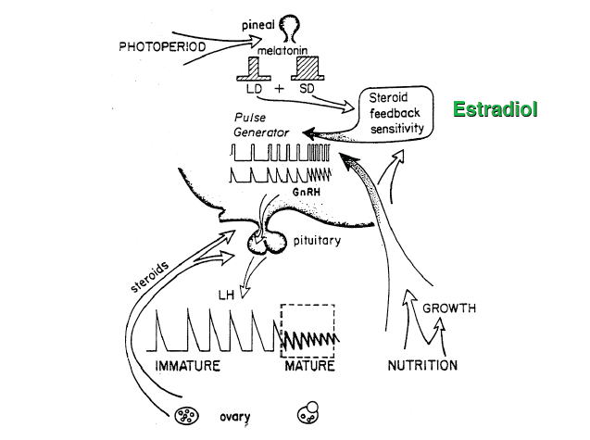

Slide 25
Seasonal Anestrus
just like entering puberty
silent ovulation

Slide 27
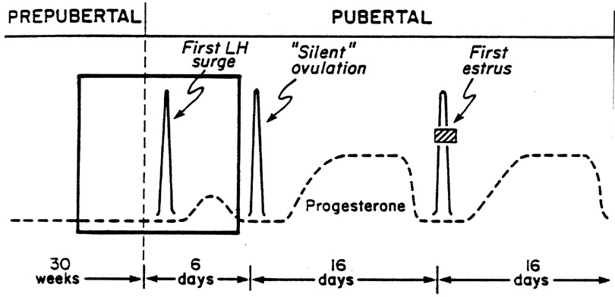
Silent Ovulation
Anestrus
Estrus

Slide 35
Recommendations:
Establish your breeding season by looking at the record of heat distribution vis-à-vis distribution of calving.
If it is too difficult to establish heat distribution, look at the calving record and plot 3 months from the peak of calving, the start of your breeding season.
Keep records religiously, systematically and efficiently.
Look at the seasonal meteorological data of your area, particularly the length of day versus night.
Remember that cows’ seasonal cyclicity also correspond to seasonality of fertility in males, thus, practice controlled or seasonal breeding.
Remember too that hormones are not a panacea. These are also affected by physiological states and responses.

Slide 36
References:
Animal Science 434 Lecture No. 9. John J. Parish. University of Wisconsin. Fall, 2008 (With Permission)
Pathways to Pregnancy and Parturition. P.L. Senger, 2nd revised edition. 2003

Slide 37
JOSE ARCEO N. BAUTISTA, DVM, PhD
For Inquiries:
Send a message to jobau57@yahoo.com

